Slide 1
Northwind Data Analysis - Mod 2 Project
File created on: 4/9/2019 2:22:50 PM

Slide 2
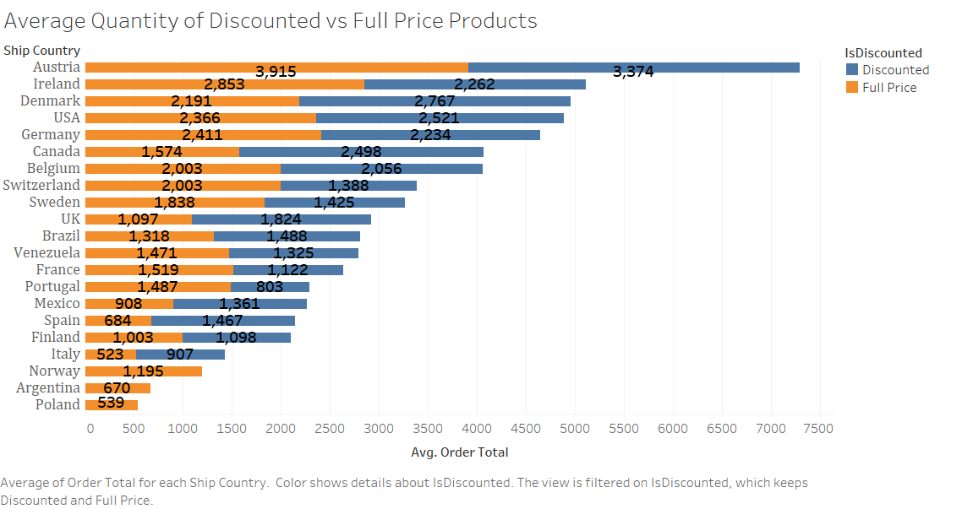

Slide 3
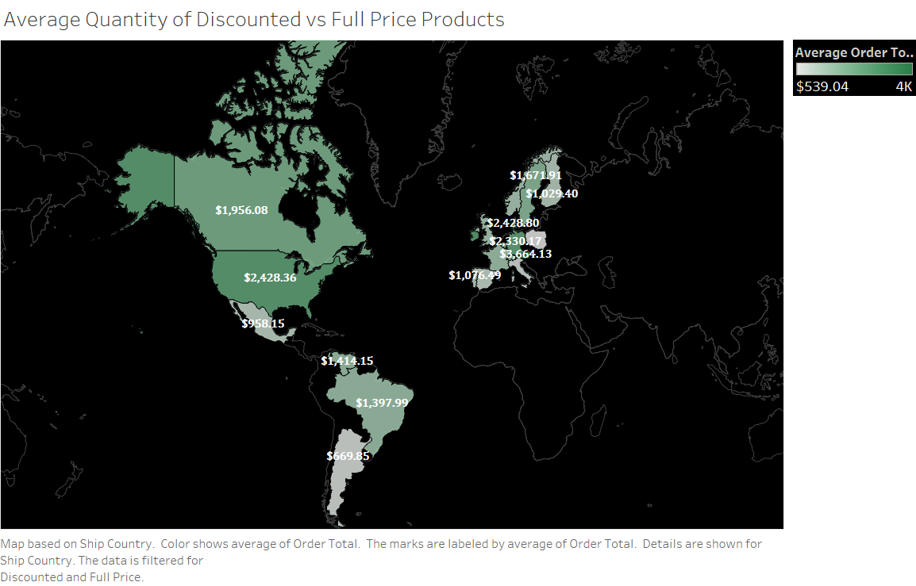

Slide 4
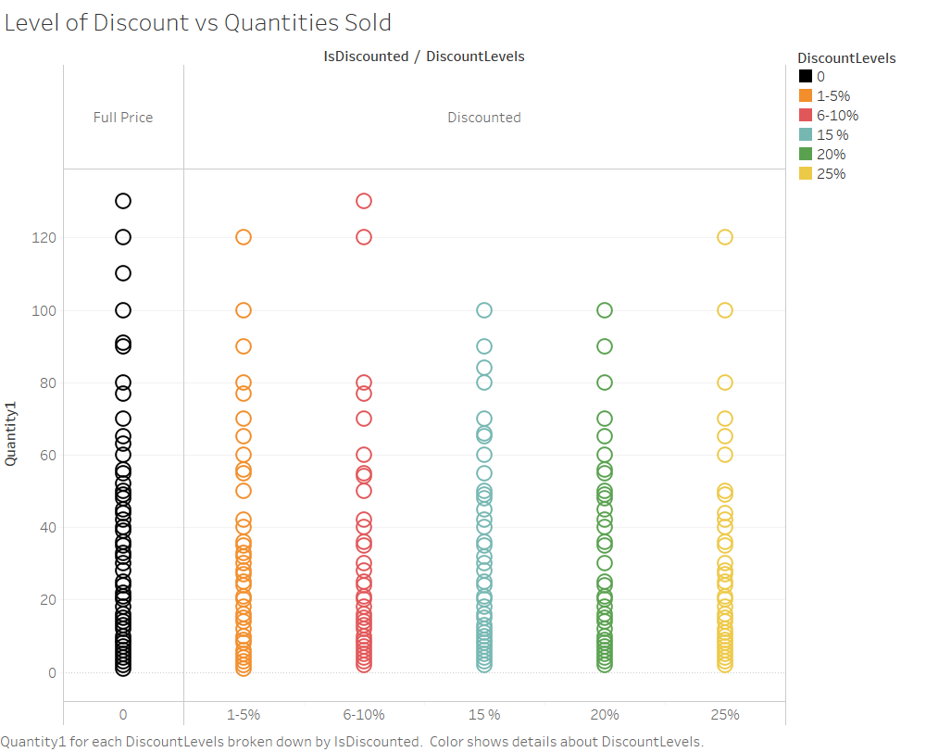

Slide 5
